Slide 1

Analysis Of Crime Data In Syracuse IST – 652
Group – 7
Mahima Jayanth
Siddharth Asati
Kenyang Lual Mirag

Slide 2
OBJECTIVE
Our chosen topic for review involves the examination of crime data available on Open Data Syracuse, a publicly accessible datasets collected by the City of Syracuse .
Our project's objectives include the analysis of various types of crimes occurring within Syracuse. We aim to determine which crimes have seen an increase or decrease in the past years and Which types of crimes are most frequently happening and which are least frequent.

Slide 3
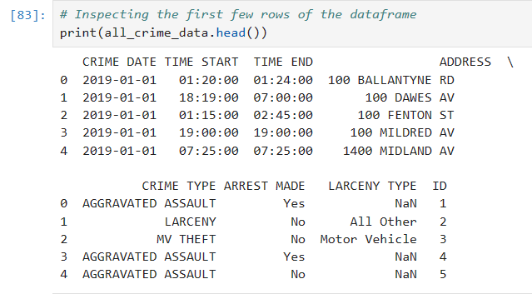
Dataset Description
Our Syracuse Crime dataset will include all the below from the year 2019 - 2022
Date End - Date that the crime was reported. It could have happened earlier. This is in the format of DD-MON-YY (Ex. 01-Jan-22).
Time start and time end - Listed in military time (2400) - Burglaries and larcenies are often a time frame.
Address - Where the crime occurred. All addresses are in the 100’s because the Syracuse Police Department allows privacy for residents and only lists the block number.
Code Defined - Offense names are listed as crime categories group for ease of understanding. There may have been other offenses also, but the one displayed is the highest Unified Crime Reporting (UCR) category.
Arrest - Means that there was an arrest, but not necessarily for that crime.
Larceny Code - Indicates the type of larceny (Example: From Building or From Motor Vehicle) . It will be crucial in analyzing the crime data.
LAT - The approximate latitude (not actual) that this call for service occurred.
LONG - The approximate latitude (not actual) that this call for service occurred.

Slide 4
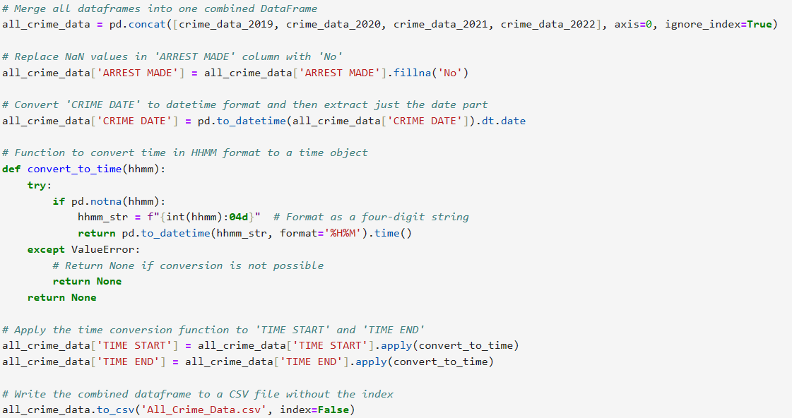
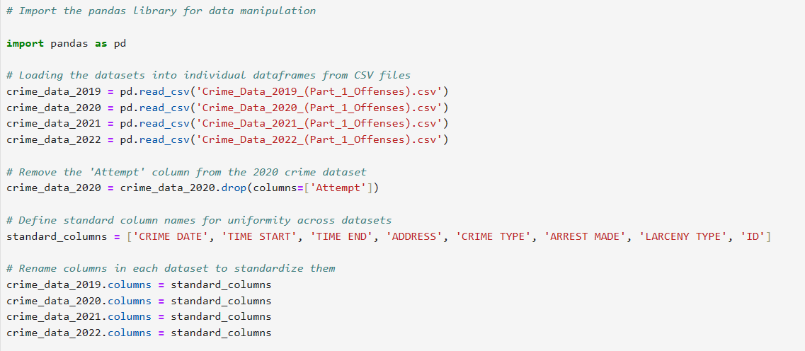
Dataset Cleaning and preparation

Slide 5
DATA ANALYSIS
Our project's core goals involve analyzing a range of crimes taking place in Syracuse. We aim to identify the most frequently occurring types of crimes, as well as those that are less commonly reported.
Additionally, we will assess which categories of crime have experienced an increase or decrease over the years .

Slide 6
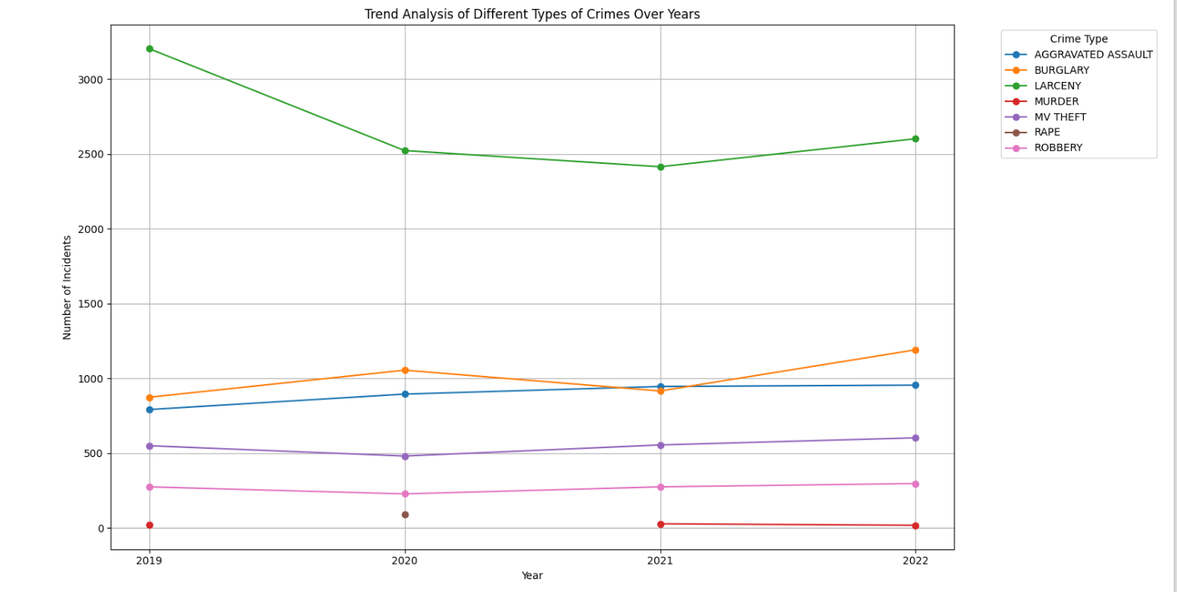
ANALYSIS 1 -
Trend Analysis of Crime Over Years at Syracuse from 2019 to 2022 –
The Syracuse crime analysis from 2019 to 2022 reveals rising aggravated assault and motor vehicle theft, with burglary also up since 2020. Larceny generally decreased, despite a high in 2019. Murders peaked in 2021, while inconsistent rape data calls for cautious interpretation.
Robberies dipped in 2020 but rebounded, possibly linked to pandemic-related social changes. These trends, though insightful, are influenced by various factors and reporting practices, and thus should guide but not solely dictate policy and public safety strategies.

Slide 7
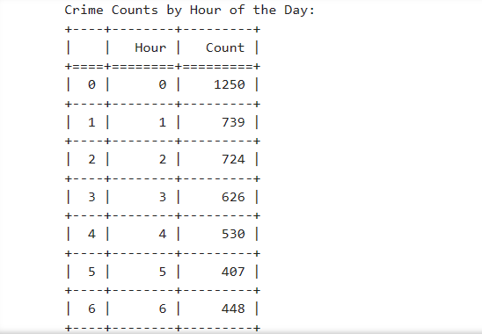
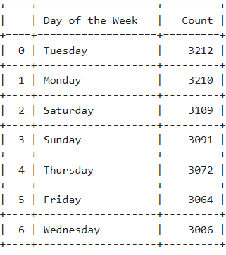
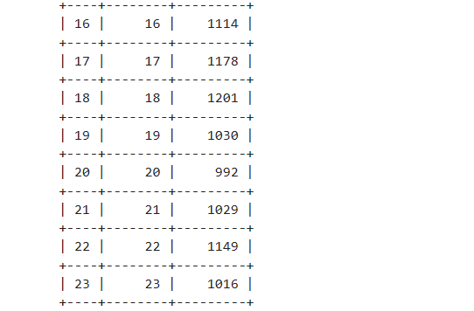
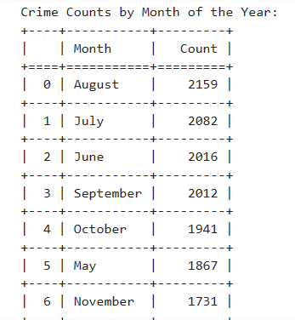
ANALYSIS 2 -
Time Analysis of Crime Incidents
The crime data for Syracuse shows midnight crime spikes, tapering off towards 5 AM, then climbing again, with a noon uptick. Crimes are fairly even across the week, with a small rise on Mondays and Tuesdays. Seasonally, August sees the most crime, with a drop in colder months, bottoming out in February. These insights suggest night and summer require more police focus, with consistent weeklong patrols despite minor early-week increases.

Slide 8
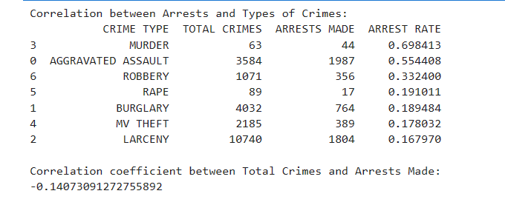
ANALYSIS 3 -
Correlation between Arrests and Types of Crimes
The crime and arrest data correlation shows murders have the highest arrest rate at nearly 70%, while aggravated assault follows with over 55%. Lesser crimes like larceny, burglary, and vehicle theft have lower arrest rates, with larceny at nearly 17%. There's a slight negative correlation of -0.1407 between crime rates and arrests, hinting that higher crime rates may lead to a marginally lower arrest ratio, possibly due to limited resources or the complexities of the crimes.

Slide 9
CONCLUSION
The crime report for Syracuse between 2019 and 2022 shows that some crimes went up and others went down. More assaults and car thefts happened, but fewer burglaries occurred after 2020.. There were more murders in 2021, but the number of rapes changed a lot and is hard to understand.
Robberies went down in 2020 but then increased again, possibly because of the pandemic.
Most crimes happen around midnight and drop off after 5 AM, but start to increase again in the daytime, especially at noon. Mondays and Tuesdays have slightly more crimes than other days. More crimes happen in August, and the number goes down in the colder months, with the fewest in February. This means police might need to work harder at night and in the summer, but they should still be around all week.
When looking at arrests, murders have the most arrests, and assaults are next. But for theft, burglary, and car theft, not as many people get arrested, especially for theft.
In short, Syracuse's crime numbers show patterns that can help make better safety plans. More police might be needed at night and in the summer, and they should look at why some crimes have lower arrest rates.

Slide 10
THANK YOU
ANY QUESTIONS ?

